Slide 1




Weijiang Xiong’s Research @
Action Recognition for Self-Driving Cars
Idea: Recognizing human actions from body poses
Normalizing Flows (NF) for Implicit Bayesian Neural Networks
Idea: Using NF to model input uncertainty/learn a soft drop-out
Visual Tracking with Correlation Filters and Siamese Networks
Idea: Combine the confidence map of two different methods
Notes:
Hello everyone, today I’m going to talk about my previous research experiences.
I have worked on three topics in the recent two years: action recognition, bayesian deep learning and visual object tracking.
Human action recognition is important for the decision making of a self-driving car. In this project we show that using body keypoints as input, even a tiny feed-forward neural network can effectively recognize basic human actions, and compare favorably against image-based methods.
Input uncertainty/noises resides in many real-world scenarios. In this project, we use normalizing flows to extend the linear and convolutional layers with a stochastic part, and use the stochastic layers to build a bayesian network that can model the input uncertainty for image classification task. The bayesian models achieve higher classification accuracy with better calibration scores.
Correlation filters and Siamese networks have been regarded as the traditional and deep learning branches of methods for visual object tracking. In this project, we show a simple combination of the score maps from the two kinds of methods will lead to significant improvements in performance.

Slide 2
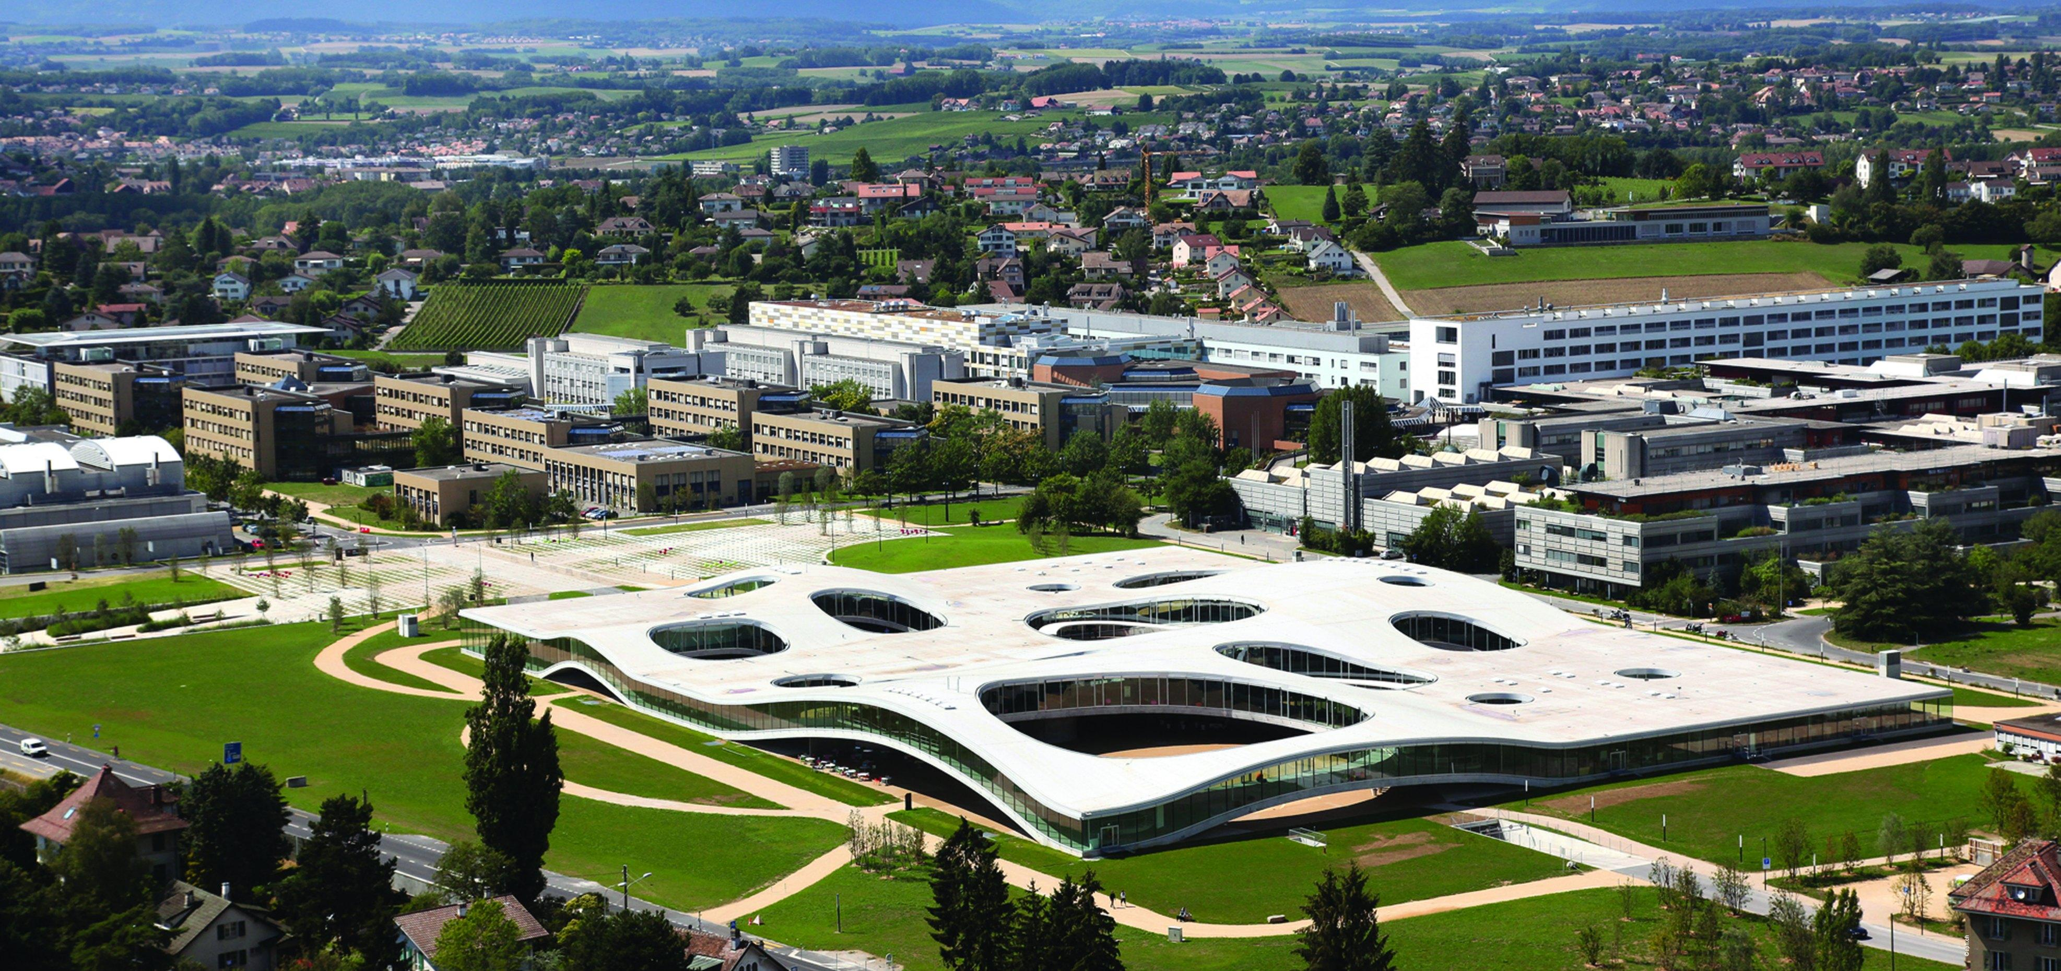
Action Recognition for Self-Driving Cars
Semester Project (15 ECTS)
Student: Weijiang Xiong (Microengineering)
Supervisor: Prof. Alexandre Alahi, Lorenzo Bertoni, Dr. Taylor Mordan
Date: Jan. 12 2022

Slide 3
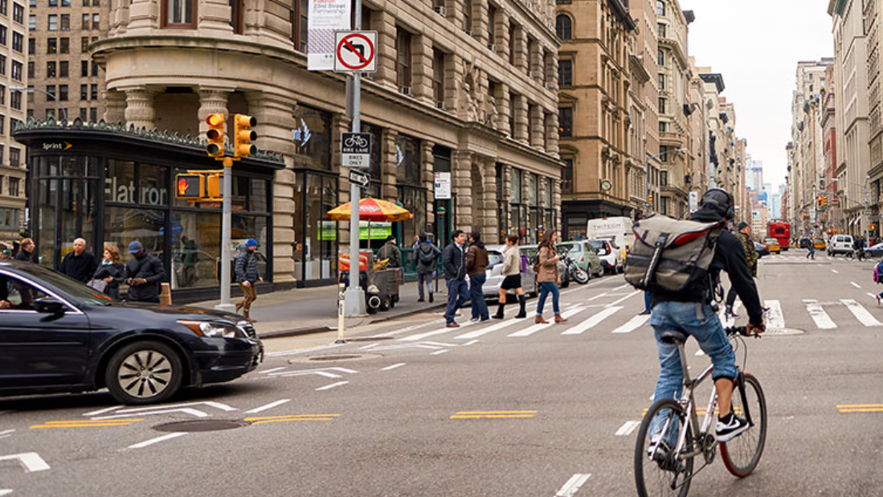
Biking
Walking
Image taken from https://usa.honda-ri.com/titan
Notes:
Action recognition means Identifying people’s actions in a video or image sequence
in this image, we can easily tell that this man is cycling, these people are walking.

Slide 4
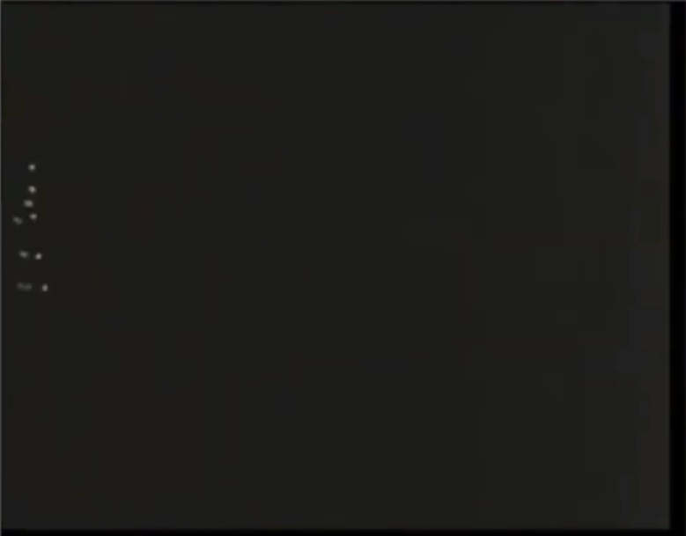
Introduction and Motivation
Action Recognition
Identify people’s actions in a video/image sequence
For self-driving cars: understand the environment, make safe decisions and plan reasonable paths
Problem Description
Input: a video or a sequence of images
Output: the type of actions for every person inside
Motivation for Pose-Based Methods
Human poses are light-weight but highly informative
Successful work on pose estimation and pose-based vision (related work)
Video Source: Justin Johnson. Umich. Deep Learning for Computer Vision. Lecture 18. 2019 Fall
Notes:
Action recognition is important for decision making of self-driving cars
and precisely, we take a video or a sequence of images, then predict people’s actions
In my project, I work with pose based methods
Because poses are light-weight but highly informative, and we can easily recognize what these people are doing, even if we just see a few points
Besides, there has been successful work on pose based vision

Slide 5
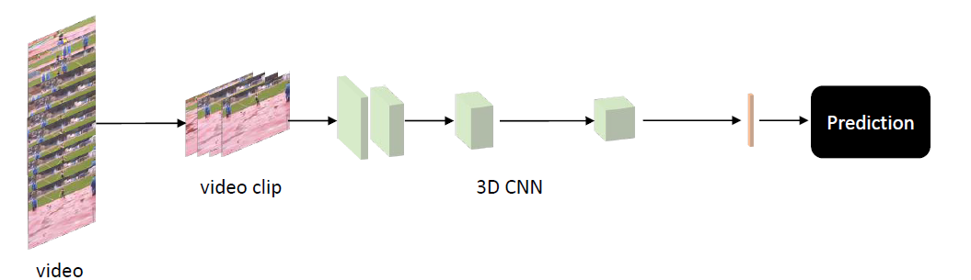
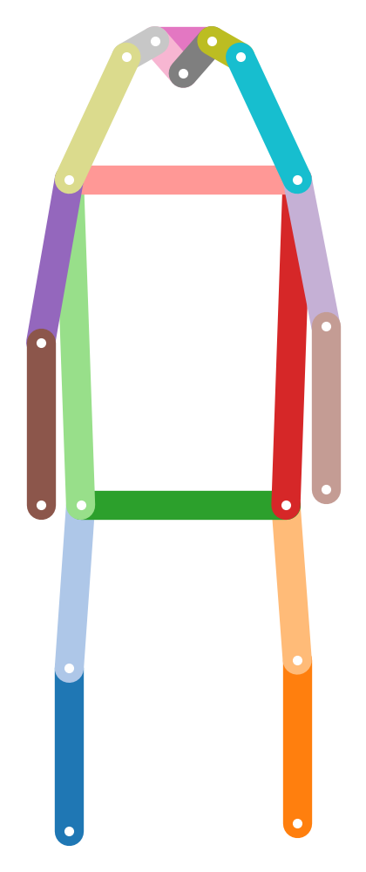
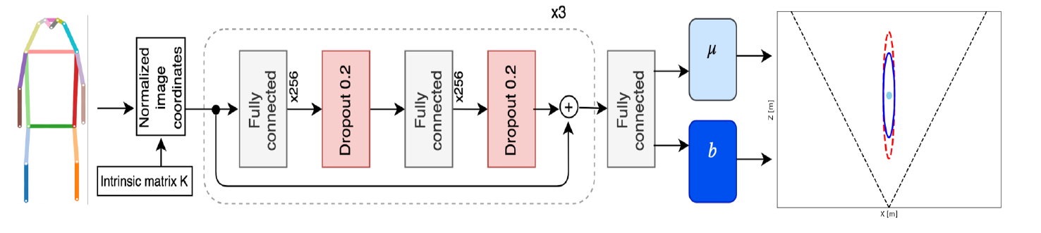
Related Work
Inflated 3D Convolution (I3D [1]) for video action recognition
computationally expensive
OpenPifPaf [2] and MonoLoco [3]
location
2D body poses
from images
uncertainty
[1] Joao Carreira and Andrew Zisserman. Quo Vadis, Action Recognition? A New Model and the Kinetics Dataset. CVPR 2017
[2] Sven Kreiss et al., OpenPifPaf: Composite Fields for Semantic Keypoint Detection and Spatio-Temporal Association. IEEE T-ITS 2021
[3] Lorenzo Bertoni et al., Monoloco: Monocular 3d pedestrian localization and uncertainty estimation. ICCV2019
Notes:
In literature, people usually use 3D CNNs for action recognition, but they are computationally expensive
Meanwhile, Monoloco takes 2D human poses from pifpaf, and predict the 3D location and uncertainty of the persons
Inspired by this, I will use a similar architecture and modify the network according to the datasets

Slide 6
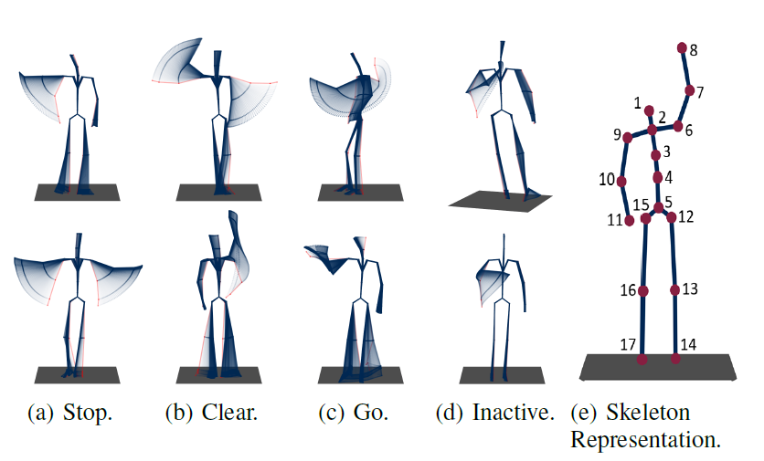
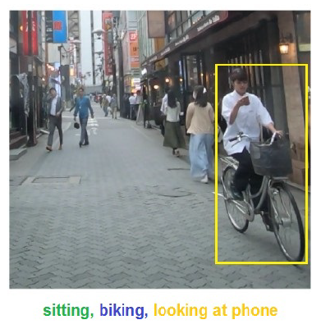
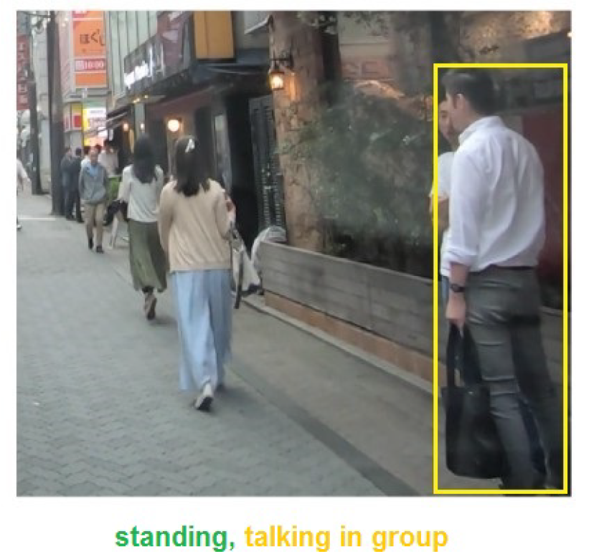
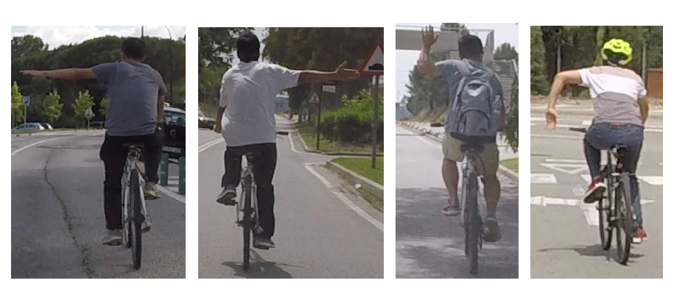
Datasets and Evaluation
TCG [4]: 3D body poses for Traffic Control Gesture
550 sequences from different actors (cross-subject evaluation) observed from multiple view points (cross-view)
TITAN [5]: 700 video clips captured with onboard camera
Annotations include five groups of actions, from individual actions (e.g., standing) to those involving context (e.g., talking in group)
CASR [6]: Cyclist Arm Signal Recognition
178 collected videos, 8 additional videos from youtube (for testing only)
Extract poses for TITAN and CASR with OpenPifPaf
[4] Wiederer et al., Traffic Control Gesture Recognition for Autonomous Vehicles. IROS 2020
[5] Malla Srikanth et al., Titan: Future forecast using action priors. CVPR 2020
[6] Fang et al., Intention Recognition of Pedestrians and Cyclists by 2D Pose Estimation. arXiv:1910.03858
Left, Right, Alternative Right, Stop
Notes:
So let’s look at the three datasets first,
TCG contains 3d body poses for traffic control gesture, and it has cross-subject and cross-view evaluation protocols to cover variations in actors and view points
The titan dataset has video clips from an onboard camera, and people’s actions are organized into five groups, from individual actions to those involving the context
CASR dataset contains video sequences for cyclist arm signal, with additional test videos from youtube

Slide 7


Poseact: Action Recognition with Human Poses
Base Network
$$× N$$
Linear Layer
Dropout
Linear Layer
Dropout
Embedded Features
Prediction head
Prediction heads
Model Name | Poseact | TempPoseact
Prediction head
Temporal Info | No | Yes
Linear 1
Linear K
Linear 1
Linear K
K=1 for TCG and CASR (usual case)
K=5 (Multitask) for five action groups in TITAN
$$⋯$$
$$⋯$$
LSTM
Notes:
Our model is called poseact
the base network remains the same as MonoLoco, we embed the keypoints with linear layers and then put the features to a prediction head.
As a general notation, the prediction head of poseact consists of multiple linear layers, one layer for one action group.
and the temporal model has an LSTM to process the features over time

Slide 8


Action Recognition Results on TCG
Method | Cross-subject (%) |  |  | Cross-view (%)
Method | Accuracy | Jaccard | F1 | Accuracy | Jaccard | F1
RNN | 82.81 | 57.40 | 69.45 | 80.94 | 57.21 | 69.98
GRU | 84.44 | 58.16 | 70.45 | 83.47 | 56.25 | 68.59
LSTM | 83.23 | 56.32 | 68.59 | 79.58 | 52.02 | 64.62
Att-LSTM | 85.67 | 50.70 | 61.87 | 85.30 | 59.87 | 71.20
Bi-GRU | 86.80 | 57.25 | 68.95 | 87.37 | 55.55 | 67.68
Bi-LSTM | 87.24 | 67.00 | 78.48 | 86.66 | 65.95 | 77.14
TCN | 83.44 | 62.06 | 74.23 | 82.66 | 63.97 | 75.95
GCN | 65.42 | 38.55 | 50.73 | 62.40 | 35.05 | 48.51
AAGCN [7] | 91.13 | - | 85.81 | 90.22 | - | 85.21
Pham et al. [7] | 91.09 | - | 86.26 | 90.64 | - | 85.52
Poseact | 85.03 | 63.72 | 76.91 | 86.29 | 68.76 | 80.81
TempPoseact | 87.31 | 69.15 | 81.15 | 87.74 | 70.11 | 81.89
$$Jaccard=\frac{TP}{TP+FP+FN}$$
Baselines from TCG paper [4]
$$F1= \frac{2 ∗precision∗recall}{precision+recall}$$
Temporal info helps, but may not be crucial in TCG
Simple architecture, but still comparable to complicated ones
[4] Wiederer et al., Traffic Control Gesture Recognition for Autonomous Vehicles. IROS 2020
[7] Pham, et al., An Efficient Feature Fusion of Graph Convolutional Networks and Its Application for Real-Time Traffic Control Gestures Recognition. IEEE Access 2021.
Notes:
so that’s the models, let’s see how they work on TCG
The TCG paper compared 8 baseline models using accuracy, jaccard index and F1 score.
our temporal model is better than all the baselines
Meanwhile, the single frame model is quite close to the temporal model, so we know temporal information helps but may not be crucial in TCG
Besides, although our model is simple, its performance is still comparable to some complicated models
the slurm job number for poseact are 779136 and 779137, and those for the Temporal model are 779140 779141

Slide 9
Action Recognition Results on TITAN
Results from TITAN paper [5]
Classification Accuracy on Test Set
Poseact uses 2D poses from OpenPifpaf
Method | I3D | 3D ResNet | Poseact (Multitask)
Backbone | InceptionV1 | ResNet50
atomic | 0.9219 | 0.7552 | 0.8001
simple context | 0.5318 | 0.3173 | 0.4797
complex context | 0.9881 | 0.9880 | 0.9780
communicative | 0.8649 | 0.8648 | 0.8369
transportive | 0.9080 | 0.9081 | 0.8980
overall | 0.8429 | 0.7667 | 0.7985
[5] Malla Srikanth et al., Titan: Future forecast using action priors. CVPR 2020
Notes:
now we move on to titan, poseact has 80% accuracy, which looks perfectly fine, but the truth is actually the opposite
slurm-780243_4294967294

Slide 10
Per-Class Recall (%) of Poseact (Multitask) on TITAN
action group | action type | Rec. | data%
communicative | looking into phone | 0 | 6.05
 | talking in group | 0 | 6.99
 | talking on phone | 0 | 3.21
 | none of the above | 0.999 | 83.76
complex context | getting in 4 wv | 0.018 | 0.13
 | getting off 2 wv | 0 | 0.23
 | getting on 2 wv | 0 | 0.12
 | getting out of 4 wv | 0 | 0.06
 | loading | 0 | 0.20
 | unloading | 0.046 | 0.75
 | none of the above | 0.992 | 98.50
atomic | bending | 0.362 | 2.17
 | jumping | 0 | 0
 | laying down | 0 | 0
 | running | 0 | 0.92
 | sitting | 0.527 | 4.37
 | squatting | 0 | 0.03
 | standing | 0.129 | 15.73
 | walking | 0.978 | 76.60
action group | action type | Rec. | data%
atomic | none of the above | 0 | 0.17
simple context | biking | 0.493 | 3.86
 | cleaning an object | 0 | 0.45
 | closing | 0 | 0.15
 | crossing legally | 0.239 | 7.64
 | entering a building | 0 | 0.67
 | exiting a building | 0.016 | 0.75
 | crossing illegally | 0.038 | 7.22
 | motorcycling | 0.3 | 0.09
 | opening | 0 | 0.22
 | waiting to cross | 0.022 | 1.27
 | walking on the side | 0.604 | 35.82
 | walking on the road | 0.703 | 25.34
 | none of the above | 0.269 | 16.54
transporting | carrying | 0.009 | 6.33
 | pulling | 0 | 0.88
 | pushing | 0.062 | 2.48
 | none of the above | 0.992 | 90.32
majority class
Notes:
Because the dataset is highly imbalanced.
For example, in the communicative actions, more than 80% are “none of the above”,
And our model is simply giving “none of the above” all the time, which is bad.
slurm-780243_4294967294

Slide 11
Class Imbalance Problem in TITAN Dataset
Use F1 score as metric
Method | I3D | 3D ResNet | Poseact (Multitask)
Metric | Accuracy | Accuracy | Accuracy | F1
atomic | 0.9219 | 0.7552 | 0.8001 | 0.3144
simple | 0.5318 | 0.3173 | 0.4797 | 0.1927
complex | 0.9881 | 0.9880 | 0.9780 | 0.1529
communicative | 0.8649 | 0.8648 | 0.8369 | 0.2278
transportive | 0.9080 | 0.9081 | 0.8980 | 0.2634
overall | 0.8429 | 0.7667 | 0.7985 | 0.2302
unweighted average over the classes
low score if always predicts the majority class
Focus on a suitable set of actions
Hard to learn context-dependent actions, especially with insifficient examples (less than 1%)
 | walking | standing | sitting | bending | biking | Overall
# Instances | 43590 | 10311 | 304 | 1297 | 2057 | 57559
# Detections | 32864 | 6746 | 189 | 932 | 1696 | 42427
Percentage | 75.4% | 65.4% | 62.1% | 71.8% | 82.4% | 73.7%
original annotation
successful detection
Notes:
To tackle the class imbalance problem, we first need additional metrics because accuracy alone could be misleading
we can use the average F1 score again, and the model get low score if it always predicts the majority class
Besides, the class imbalance problem could overwhelm the training progress, therefore we have to focus on a suitable set of actions.
As a result, we decided to selected these five actions, walking standing sitting bending and biking.
In general, pifpaf correctly detects about 74% of all the annotated persons, Therefore the selected dataset still has reasonable quality.
slurm-780243_4294967294

Slide 12
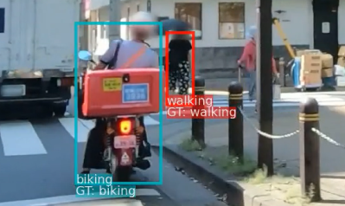
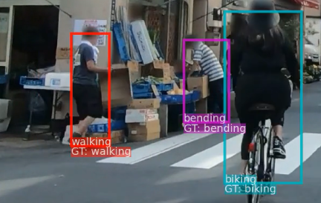
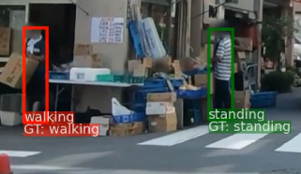
Experiments on Selected Actions
F1 score on the selected actions
Method | walking | standing | sitting | bending | biking | Overall
Poseact (Multitask) | 0.884 | 0.214 | 0.311 | 0.457 | 0.541 | 0.481
ResNet50 [8] | 0.885 | 0.225 | 0.01 | 0.063 | 0.536 | 0.344
Poseact | 0.919 | 0.553 | 0.771 | 0.621 | 0.839 | 0.741
TempPoseact | 0.927 | 0.672 | 0.710 | 0.482 | 0.771 | 0.712
trained on all 5 action groups
tested on selected actions
trained on selected actions,
not multitask
Recognition examples from Poseact
[8] He et al., Deep Residual Learning for Image Recognition. CVPR 2016
Notes:
here are the results after selecting the actions.
The multitask poseact was trained on the original titan dataset, and tested on these selected actions.
probably it has been overwhelmed by “none of the above”, and thus has bad performance
When we train the models on selected actions, we find the temporal model can better classify walking and standing, while the single frame model is better for sitting, bending and biking.
Here are a few recognition examples from the single frame model, and we can see the model works ok for these actions

Slide 13
Effect of Preprocessing and Temporal Module
Using Relative Keypoint Coordinates
17 Absolute coordinates => 1 center location + 17 relative coordinates
Center Point
Possible reason: multiple persons in an image, but their actions are not related with their absolute locations, only the body poses matter
F1 score for each class
Relative coordinates >> absolute coordinates; center point is not very important
When using temporal models, we need object track ID to connect new poses to previous ones
Method | Walking | Standing | Sitting | Bending | Biking | Average
Poseact | 0.919 | 0.553 | 0.771 | 0.621 | 0.839 | 0.741
Abs. Coord | 0.887 | 0.263 | 0.685 | 0.478 | 0.582 | 0.579
Rm. Center | 0.921 | 0.577 | 0.742 | 0.598 | 0.827 | 0.733
TempPoseact (GT) | 0.927 | 0.672 | 0.710 | 0.482 | 0.771 | 0.712
TempPoseact (PifPaf) | 0.923 | 0.653 | 0.575 | 0.467 | 0.761 | 0.676
use absolute coordinates
remove center point
groundtruth object track ID
PifPaf object track ID
Notes:
For TITAN dataset, it’s effective to use relative keypoint coordinates, instead of absolute coordinates.
Pifpaf gives 17 keypoints for a person, and we transform them into one center point plus 17 relative coordinates
A reason is that there are multiple persons in an image, but their actions are not related with their locations.
if we use absolute coordinates, the average F1 will degrade significantly but the center point doesn’t matter that much
Besides, when using temporal models, we need object track IDs to connect new poses to previous ones, and using the groundtruth track ID generally works better than pifpaf track ID

Slide 14
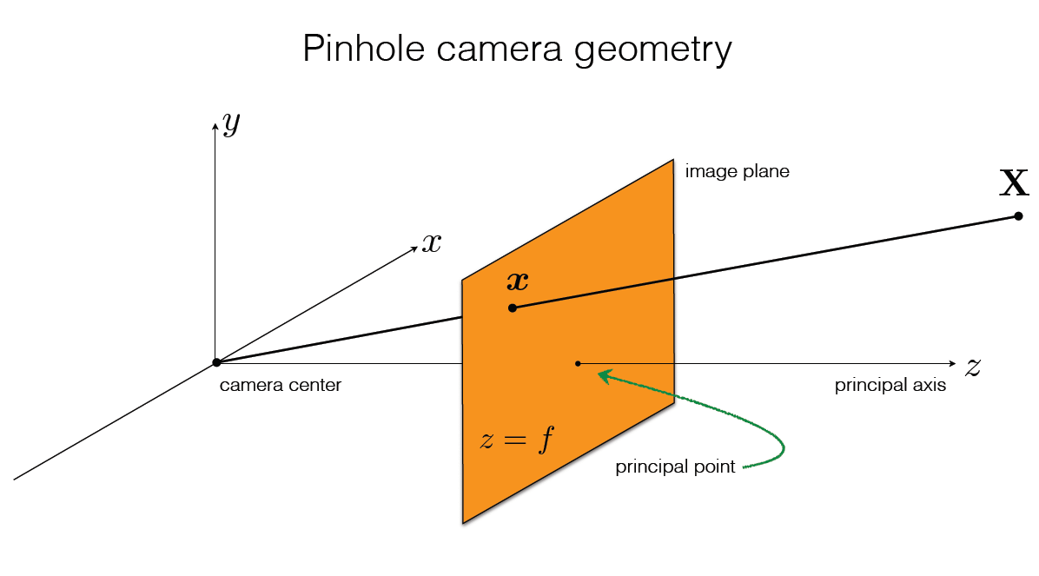
Explorative Experiments
Project 3D poses in TCG onto the image plane of a “virtual camera” (acc 20% lower)
Possible reason: difficult to choose a proper camera pose to keep the actor in FOV
Picture from CMU 16-385 Computer Vision (Kris Kitani) Lecture 11.1 Camera Matrix
Notes:
After these studies, I conducted a few explorative experiments
in TCG, I tired to project the 3D poses onto the image plane of a virtual camera, the accuracy becomes 20% lower than before.
Because it could be difficult to choose a proper camera pose

Slide 15
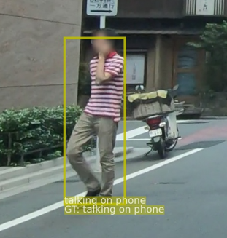
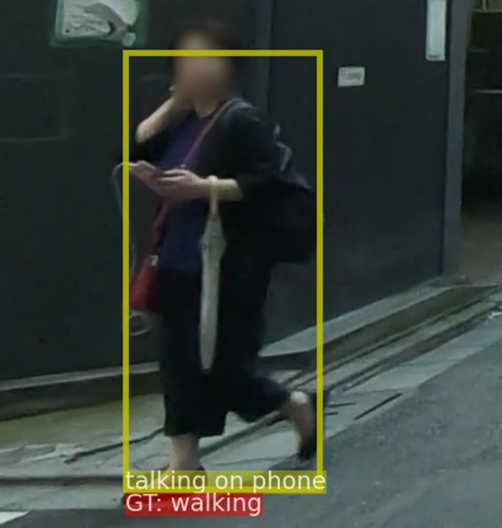
Explorative Experiments
Project 3D poses in TCG onto the image plane of a “virtual camera” (acc 20% lower)
Possible reason: difficult to choose a proper camera pose to keep the actor in FOV
In TITAN, add phone related actions to selected action set (only ~25% F1)
Possible reason: these actions are context-dependent, body poses may not be sufficient
Notes:
In TITAN, I tried to add phone related actions to the selected action set, but we only have 25% F1 score
because they are highly context-dependent, for example this gentleman is talking on the phone, but this lady who has a similar pose is not talking on the phone, however we can’t know this with poses alone

Slide 16
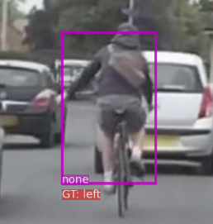
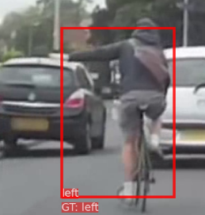
Explorative Experiments
Project 3D poses in TCG onto the image plane of a “virtual camera” (acc 20% lower)
Possible reason: difficult to choose a proper camera pose to keep the actor in FOV
In TITAN, add phone related actions to selected action set (only ~25% F1)
Possible reason: these actions are context-dependent, body poses may not be sufficient
Apply the models to CASR dataset
Good performance on test set, but not on test videos from youtube
Possible reason: the dataset is collected seriously (standard arm signal), but people are more casual in real-life (out-of-distribution problem)
Method | Testset |  | Youtube Set
 | Acc | F1 | Acc | F1
Poseact | 0.93 | 0.91 | 0.68 | 0.47
TempPoseact | 0.92 | 0.89 | 0.66 | 0.46
Heuristics [9] | 0.72 | 0.50 | 0.79 | 0.75
Random Forest [6] | 0.93 | 0.92 | 0.82 | 0.76
[6] Fang et al., Intention Recognition of Pedestrians and Cyclists by 2D Pose Estimation. arXiv:1910.03858
[9] https://github.com/charlesbvll/monoloco
Notes:
As for the CASR dataset, our models have good performance on testset, but no on youtube videos
The reason is that, when making the dataset, the actors use standard arm signal, like this image, but in real life, people are quite casual. So this is probably an out-of-distribution problem.

Slide 17
Discussions
Project Summary
Learned the recent progress of action recognition
Created an evaluation code base for TCG, TITAN and CASR
Experimented basic feed-forward model and temporal model for pose-based action recognition
Explored preprocessing techniques and generalization applications
Key Takeaways
A basic feed forward model can recognize non-context-dependent actions from poses
When multiple persons exist in a frame, it’s better to use relative keypoint coordinates
Take care of the out-of-distribution problem when transferring to different datasets
Future Work
Advanced models (graph-based, attention mechanism), additional features (speed, angular speed)
Methods to promote out-of-distribution performance
Github:https://github.com/Weijiang-Xiong/Action_Recognition
Notes:
In summary, this project has been an excellent journey to me.
I learned about action recognition, created my own code base, conducted experiments and finally explored some ideas.
My key findings are these.
First, a basic feed forward network works ok
second, we can use relative keypoint coordinates
finally, we need to take care of the out-of-distribution problem
In the future, we can try more advanced models or more features, and it would also be interesting to investigate the out-of-distribution performance.
That’s all about my project, thanks for listening.

Slide 18
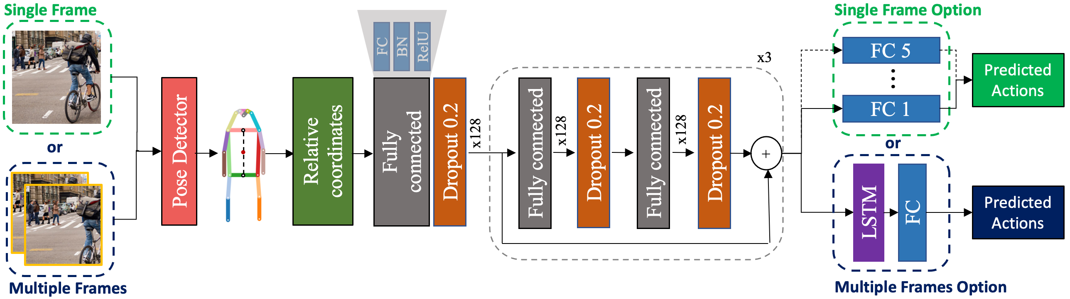
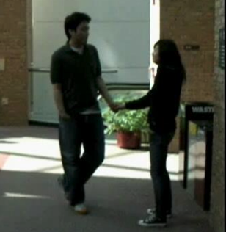


$$× N$$
Image
Linear Layer
Dropout
Linear Layer
Dropout
Embedded Features
Linear
Preprocessing
FC
BN
RelU
Prediction
Head
Variants of Prediction head
x3
Temporal
Multitask
FC 1
Fully
connected
Dropout 0.2
Fully connected
Dropout 0.2
Fully connected
Dropout 0.2
FC
LSTM
FC
Relative
coordinates
x128
x128
x128
Pose Detectoor
Predicted
Actions
$$⋯$$
+
FC 5

Slide 19
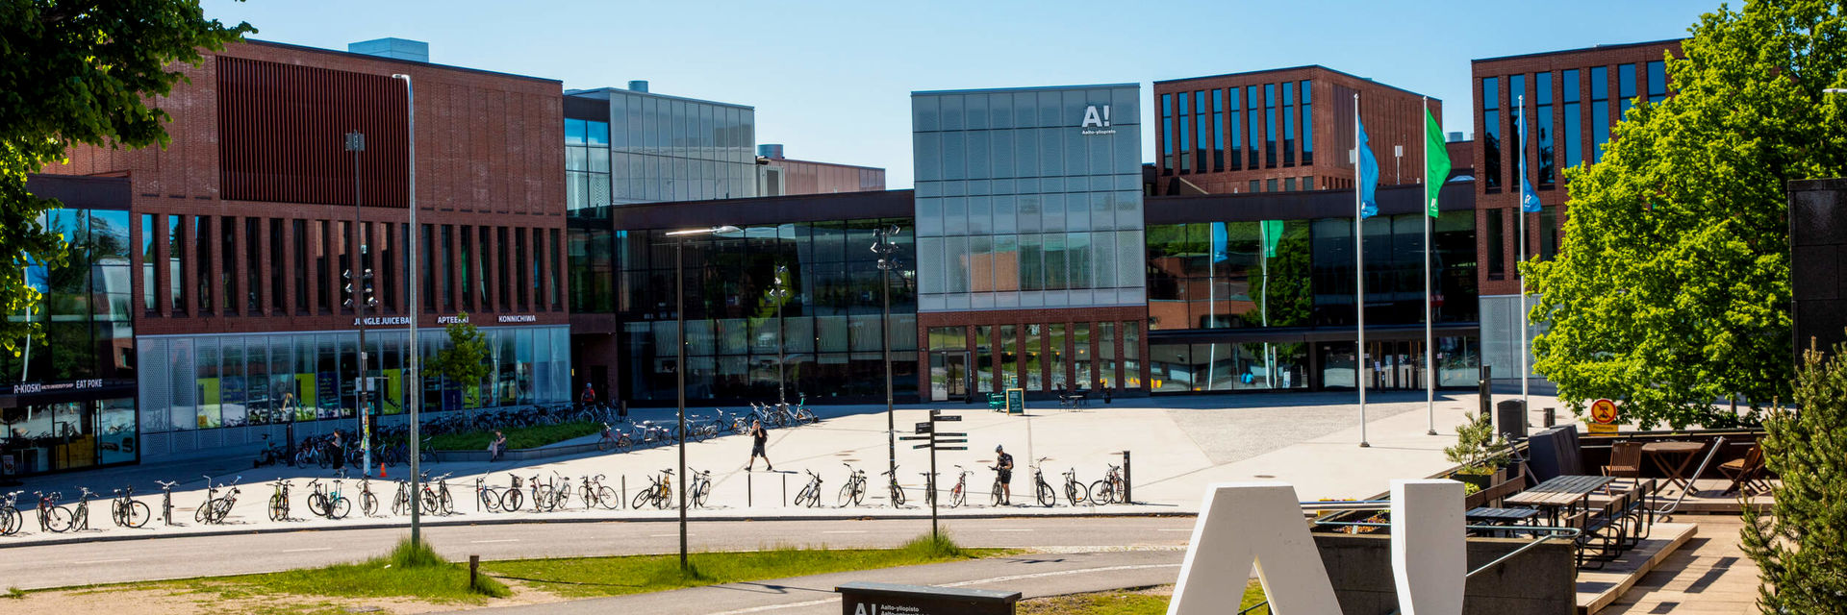
Bayesian Deep Learning:
Normalizing Flows for Implicit Bayesian Neural Networks
Summer Project
Aalto PML
Student: Weijiang Xiong
Supervisor: Dr. Markus Heinonen
24th August 2021
Notes:
my summer project is a topic under the broad context of Bayesian deep learning, and I mainly worked on normalizing flows for implicite Bayesian neural networks

Slide 20
Contents
Introduction: Motivation, Challenge and Idea
General Network Structure
Properties and Examples of Normalizing Flow
Loss Formulation
2D Binary Classification Example
Experiment with LeNet and VGG
Discussions
Notes:
I’ll start with the motivation, challenges and idea of my project, followed by the general network structure
Then I’ll briefly introduce normalizing flow, and show the formulation of the loss function
after that I’ll present some experiments and conclude with a few discussions

Slide 21
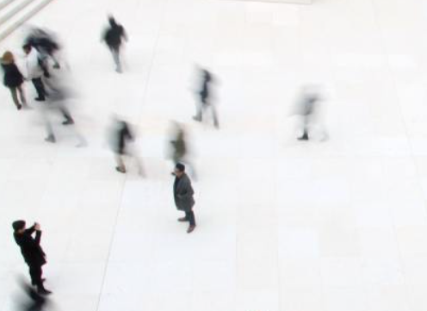
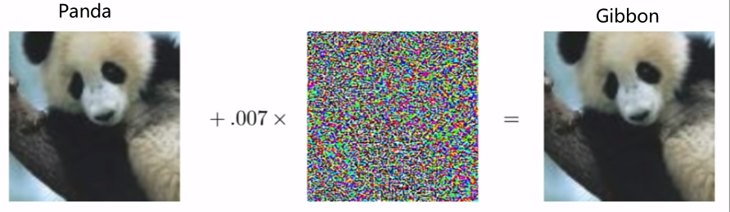
Introduction
Motivation for Bayesian Deep Learning
  Classic deep learning only provides a point estimation (deterministic)
Realworld data contains uncertainty (sensor noise), Decision making needs uncertainty
  Deep neural nets tend to be over confident, even if the results are wrong
  Network better be calibrated (reasonably confident) and predict uncertainty as well
[1] Left image: https://www.masterclass.com/articles/how-to-capture-motion-blur-in-photography
[2] Right Image: Ian Goodfellow, CS231N Lecture Adversarial Examples and Adversarial Training
Notes:
The motivation of this project comes from two problems in deep neural networks
the first is, they only provide a point estimation, so we call them deterministic networks
but ---
the second problem is, they tend to be over confident. in this adversarial attack example, a neural net classifies this panda as a gibbon with high confidence, which is bad …
reasonably confident,

Slide 22
Introduction
Motivation for Bayesian Deep Learning
  Classic deep learning only provides a point estimation (deterministic)
Realworld data contains uncertainty (sensor noise), Decision making needs uncertainty
  Deep neural nets tend to be over confident, even if the results are wrong
  Network better be calibrated (reasonably confident) and predict uncertainty as well
Challenges in Bayesian Deep Learning
  Neural Nets have too many parameters, difficult to sample a distribution on weights
  Difficult to construct expressive but tractable distributions
Project idea
  Model the input uncertainty (not on weights) with the Implicit BNN [1]
  Build up an expressive distribution with a series of Normalizing Flows
Implicit BNN. Trung Trinh, Samuel Kaski, Markus Heinonen. Scalable Bayesian neural networks by layer-wise input augmentation https://arxiv.org/abs/2010.13498
Notes:
However, deep neural nets … , and it’s difficult
Besides, it’s also difficult
Therefore my project idea is to … and …
what are they and how are they connected?

Slide 23
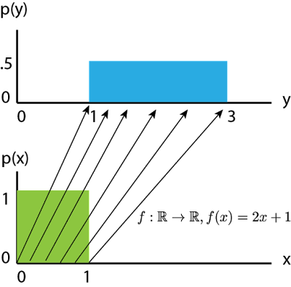
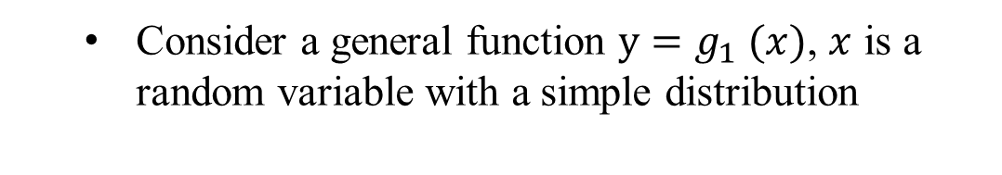


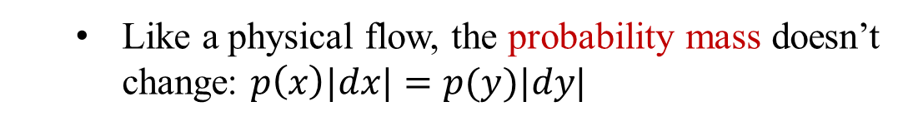

Normalizing Flows: Properties
Transform a distribution with invertible functions
  Consider a general function $y=g_{1} (x)$, $x$ is a random variable with a simple distribution
  An interval [$x$, $x+dx$] is mapped to [$y$, $y+dy$]
  Like a physical flow, the probability mass doesn’t change: $p\left(x\right)|dx|=p(y)|dy|$
  In log space:
$$\log{p(y)}=\log{p\left(x\right)+\log{|dx/dy|}}$$
The inverse of volume change
(need invertible functions)
  Another function $z=g_{2}(y)$,
$$\log{p(z)}=\log{p\left(y\right)+\log{|dy/dz|}}$$
Obtain $p(z)$with functions $g_{1}$, $g_{2}$
Eric Jang. Normalizing Flows Tutorial. https://blog.evjang.com/2018/01/nf1.html
Rezende, Danilo, and Shakir Mohamed. Variational inference with normalizing flows. International conference on machine learning. PMLR, 2015.
Notes:
first, normalizing flow allows us to transform a distribution with invertible functions
consider …
image we push the probability mass through a flow, and the interval [x, x+dx],
like a … that is density * volume
we can write the density of y in log space, and the absolute value of dx/dy means …
when dealing with a series of flows, each flow works independently, and if we connect this flow with another flow, we can easily add up these two equations
logpy cancels out, and we have the density of z, a complicated one, with a simple variable x and two functions g1 and g2

Slide 24

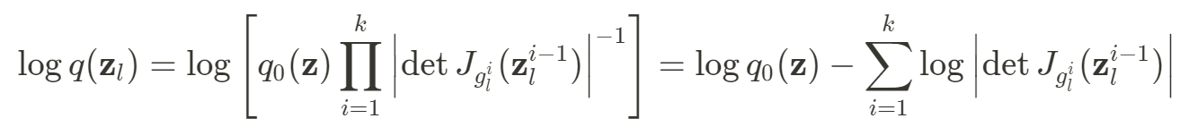
Normalizing Flows: Properties
Build complex distribution with a series of transform
scalar => vector
volume change => determinant of Jacobian
Jacobian evaluated at the output of previous flow
Pros and cons of NF
  Parameters can be learned to construct complicated distributions (in theory)
  Need to calculate the determinant of Jacobian (expensive)
  Need to carefully choose invertible functions to make computation tractable
Eric Jang. Normalizing Flows Tutorial. https://blog.evjang.com/2018/01/nf1.html
Rezende, Danilo, and Shakir Mohamed. Variational inference with normalizing flows. International conference on machine learning. PMLR, 2015.
Notes:
Therefore we can build ….
if we generalize into vector case, volume change becomes det jacobian
since each flow works independently, we only need the jacobian …
however, it’s usually expensive to calculate the determinant of a matrix, so we need to carefully choose some tractable transform

Slide 25
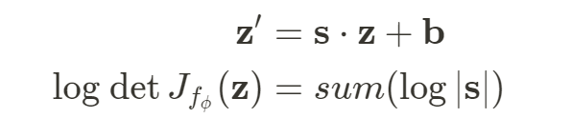
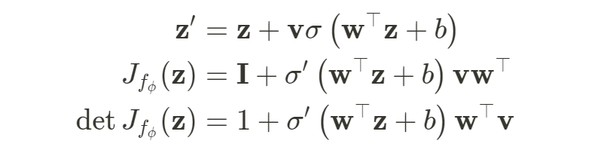


Normalizing Flows: Examples
Affine Transform
  Scale and shift the original vector:
  log determinant:
Planar Flow
tanh function
  Transform:
  Jacobian matrix:
  determinant:
Invertible 1x1 Convolution (Glow, for images)
  2D Convolution:
shared matrix for all (height, width) positions
  log determinant:
Kingma, Durk P., and Prafulla Dhariwal. "Glow: Generative flow with invertible 1x1 convolutions." Advances in neural information processing systems 31 (2018).
Notes:
Here are some examples of tractable flows
Affine transform is quite straight forward, and we just scale and shift the input vector
planar flow contains an activation function, and looks a bit more complicated, but its determinant turns out to be quite easy
Another example is the Invertible 1x1 Convolution in Glow, which is designed for image generation
the idea is to multiply all elements xij in an image, with a shared matrix W, and the element-wise log

Slide 26


General Network Structure
Neural Network
Stochastic Layer
Deterministic
Det. Compo
Input
Det. Compo
Base + NF
Stochastic
transformed
samples
$$↑$$
samples
deterministic
(linear, conv)
Det. Layers
Base Dist.
NF
$$↑$$
stochastic
Det. Compo
Flow Layer
Flow Layer
Flow Layer
transformed
samples
samples
$$⋯$$
Base + NF
Implicit BNN. Trung Trinh, Samuel Kaski, Markus Heinonen. Scalable Bayesian neural networks by layer-wise input augmentation https://arxiv.org/abs/2010.13498
Notes:
so that’s normalizing flows, and here is how we use them

Slide 27
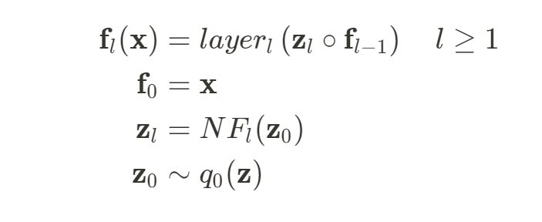
Inside a stochastic layer
Stochastic Layer with Normalizing Flow
transformed samples * original input
Deterministic
Input
Det. Compo
Transform with NF
Stochastic
transformed
samples
samples
Base Dist.
NF
Sample from a base distribution
Intuitive Understanding
  Probabilistic : model the input uncertainty with the flow based distribution
  Soft Dropout: multiply the input with real-numbered values instead of 0s and 1s
  (patch dropout)
Implicit BNN. Trung Trinh, Samuel Kaski, Markus Heinonen. Scalable Bayesian neural networks by layer-wise input augmentation https://arxiv.org/abs/2010.13498
Notes:
Let’s look at the general structure of the implicit bnn
the IBNN extends a deterministic layer with a stochastic branch
before we put the data/feature into a network layer, we sample … then transform the samples … and I mainly worked on this flow part
finally, we multiply the samples with the original data/feature
This structure has nice intuitive interpretations.
in a probabilistic way, …
in a non-probabilistic way, the stochastic part can be regarded as

Slide 28
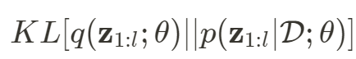
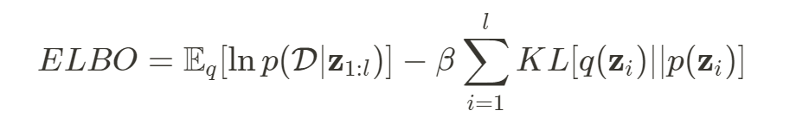
Loss Formulation
Evidence Lower Bound (ELBO)
  Approximate the true distribution $q$ with a flow-based distribution $p$:
latent variable in all layers of a neural network
weights of deterministic part (can be copied)
  Equivalent to maximizing
assume independent layers, and split them
data likelihood (cross entropy loss)
regularization
  Likelihood only needs final prediction, but KL needs more consideration
Implicit BNN. Trung Trinh, Samuel Kaski, Markus Heinonen. Scalable Bayesian neural networks by layer-wise input augmentation https://arxiv.org/abs/2010.13498
Notes:
With all the components, let’s move to the loss formulation
In the first place, we want to approximate the true posterior distribution of latent variable p(z|D, theta),
with a flow-based distribution q(z; theta)
here z means .. theta is .. and D is data
That is equivalent to maximizing the ELBO, which contains a data likelihood term and regularization term.
if we assume the latent variables in different layers are independent, we can decompose the full KL into a sum over all layers
while the likelihood …

Slide 29
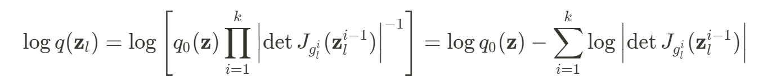
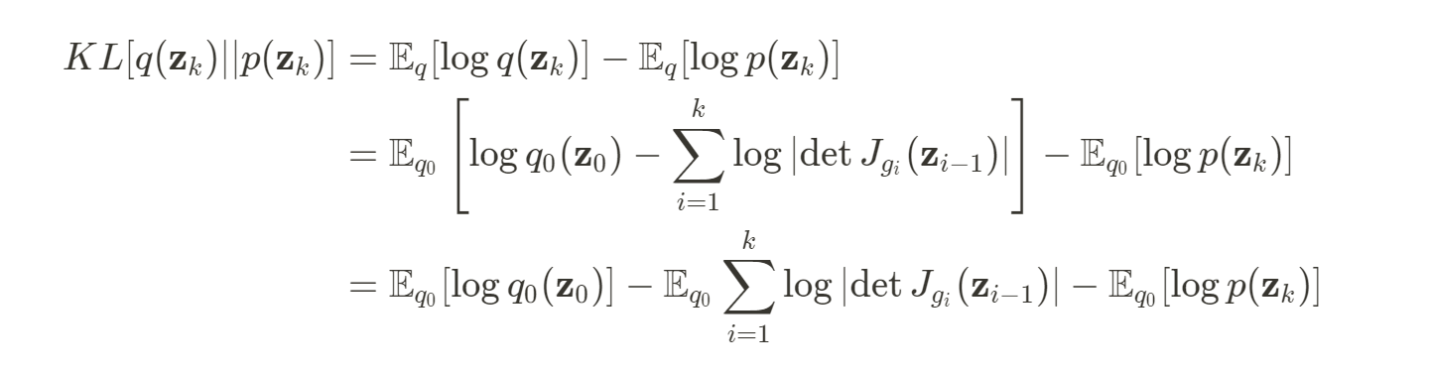
Loss Formulation
Evidence Lower Bound (ELBO)
KL for one layer
the k th flow in this layer
from flows
change of variable
log probability of initial samples in base distribution
log probability of transformed samples in prior distribution
sum of log det Jacobian from flow
Notes:
For simplicity we just take one layer,
the notation is actually a bit tricky here, the subscript means the kth flow in a layer
we first plug in the density of transformed samples, then with the change of variable technique,
we can take the expectation over the simple base distribution, instead of the complicated flow posterior
finally the kl decomposes into three terms …

Slide 30
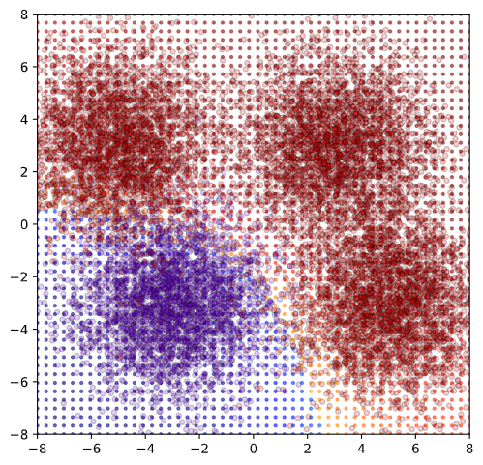
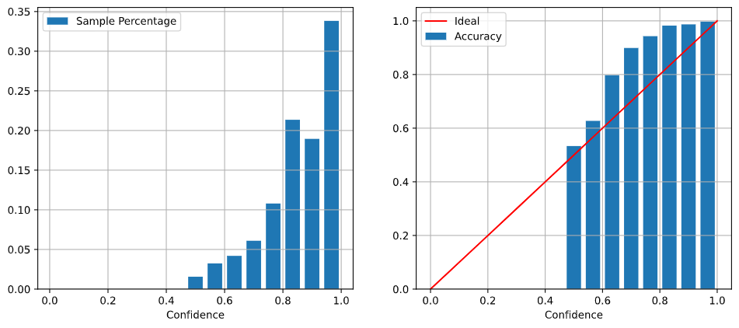
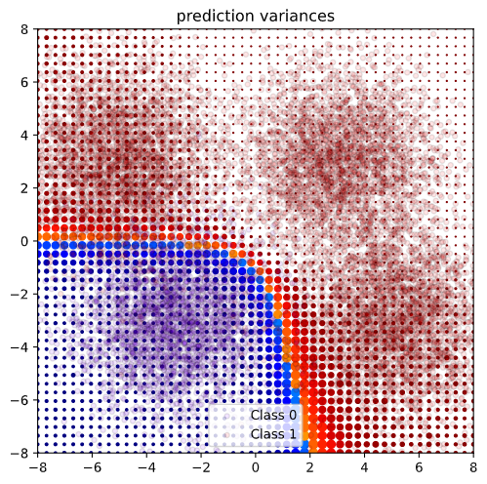
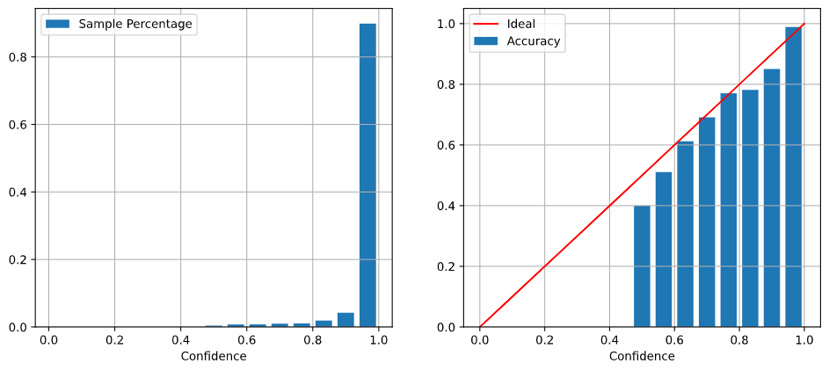
2D Binary Classification
ECE = sum(abs(ACC-Conf)*sample_percentage)
MLP Model
2 Linear Layers
ACC 95.3%
ECE 0.0941
MLP (flow)
2 Linear Layers
Each with 6 planar flows
copy weights from base MLP
ACC 96.5%
ECE 0.009
Notes:
That’s all the theory part, now let’s see some experiments
here is a toy classification problem, and we have a deterministic MLP and a flow based MLP
both have 2 layers, and the flow model has 6 planar flows for each layer
in the second plot, the size of the dots indicates the variance, and we can see it’s quite reasonable
the flow based model is actually initialized with the deterministic mlp, so their boundary looks similar
Apart from classification accuracy, we have a measurement called expected calibration error, ECE, which measures the differences between model confidence and actual accuracy, the lower the better
we can see the flow based MLP has higher accuracy and lower ece, which is great

Slide 31
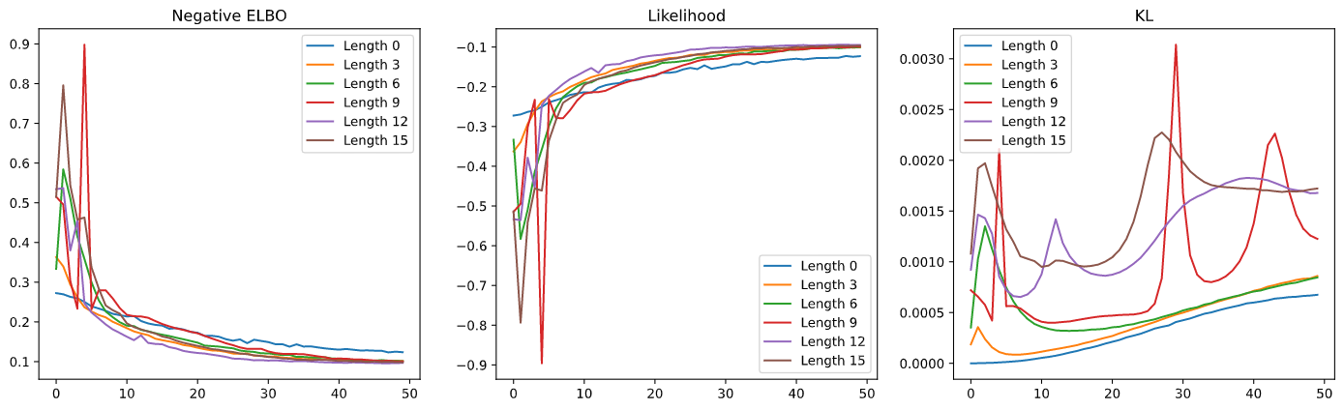
2D Binary Classification
Loss values at each epoch with different flow depths
  The model without flow has lowest KL and data likelihood (log) after training
  In this case, the flow with length 12 has best ELBO
no flow
Training Epochs
Training Epochs
Training Epochs
Notes:
here are the training loss of the model with different flow depths
as a result, the model without ….
the likelihood first increases as the flow becomes deeper, and but then decreases a bit
in this case the flow with

Slide 32
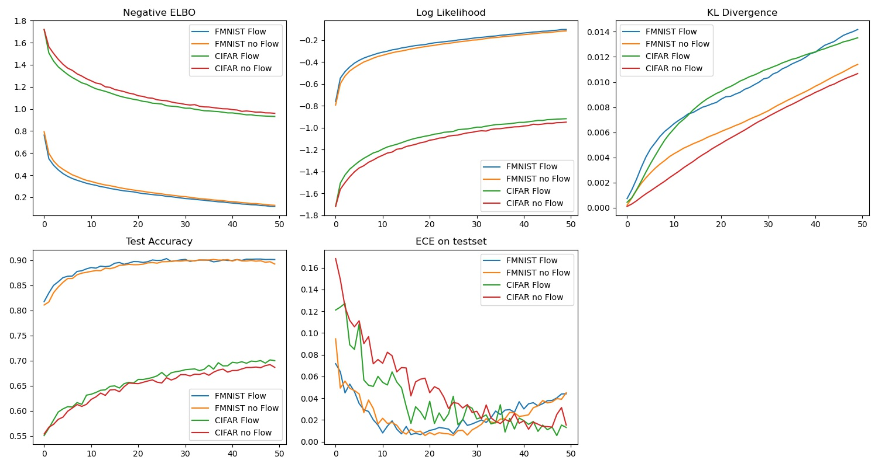
Training Log of NF on LeNet (5 layers)
Flow config: Normal, InvConv, Normal, Planar, Normal
Flow: $z$ ~ NF(Normal(1, 0.5))
no Flow: $z$ ~ Normal($μ$, $σ$) learnable
FashionMnist Baseline
Deterministic LeNet (best in 50 epochs)
  FashionMnist : ~89% ACC, ~1.5% ECE
CIFAR10 Baseline
LeNet Dropout
  CIFAR-10: ~65% ACC, ~1.5% ECE
Using Dropout on LeNet:
Same ACC, ECE up to 3~5%
Baseline
Notes:
however, the results become more unpredictable as I moved to bigger models
I experimented the effect of flow on LeNet5, with FashionMNIST and CIFAR10
For the flow part , I used invertible 1x1 convolution for the second convolution layer, and planar flow for the second fully connected layer
For the no flow version, the stochastic part does not have a flow, but only a normal distribution with learnable mean and variance
I trained a deterministic version on the two datasets, and used them as baseline.
I also tried to add dropout to LeNet, but the results doesn’t change much
As a result, both the flow and no flow version outperforms the deterministic baseline, because the test accuracy is higher than baseline
but the flow has little effect on FashionMNIST.
probably it’s because the dataset is simple, and the deterministic model itself is enough to model it
When we look at the test accuracy from cifar, the flow now shows some effect, the test accuracy

Slide 33
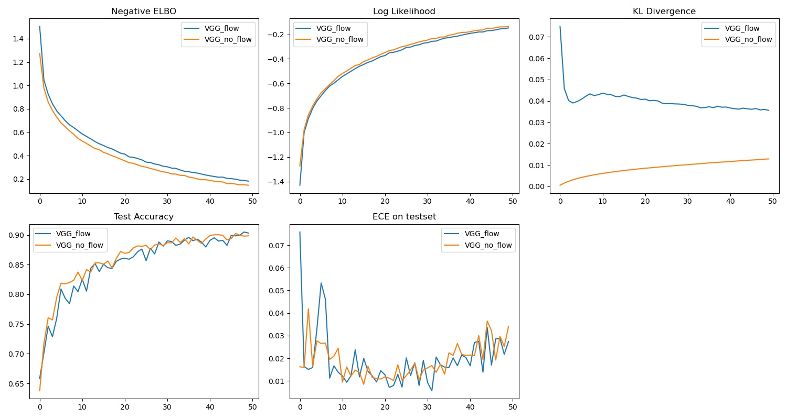
Training Log of NF on VGG16
Flow: $z$ ~ NF(Normal(1, 0.5))
no Flow: $z$ ~ Normal($μ$, $σ$) learnable
Baseline
Baseline
Deterministic VGG (best in 80 epochs)
  CIFAR-10: ~87% ACC, ~7% ECE
Notes:
the results with VGG on CIFAR supports that interpretation
both stochastic models outperform the deterministic baseline, but the flow is not helpful here
an evidence is that the KL decreases as training goes on the KL divergence is decreasing, which means the posterior is gradually going back to the prior
so I think VGG 16 has enough capacity for CIFAR 10, and the flow gradually loses its value

Slide 34
Discussions
Key Findings in Project
  Normalizing flow is a tractable way to construct/learn flexible distributions
  Choosing the structure of flow needs a lot of engineering insight
  A flow increases the model’s capacity, and (good case) improve accuracy and calibration
  If the model has enough capacity, adding a flow won’t be much helpful
Future Directions
  More experiments to inspect the effect of flow
  Limit the design space with pre-defined blocks
https://github.com/Weijiang-Xiong/iBNN_NF/tree/master/project_summary

Slide 35
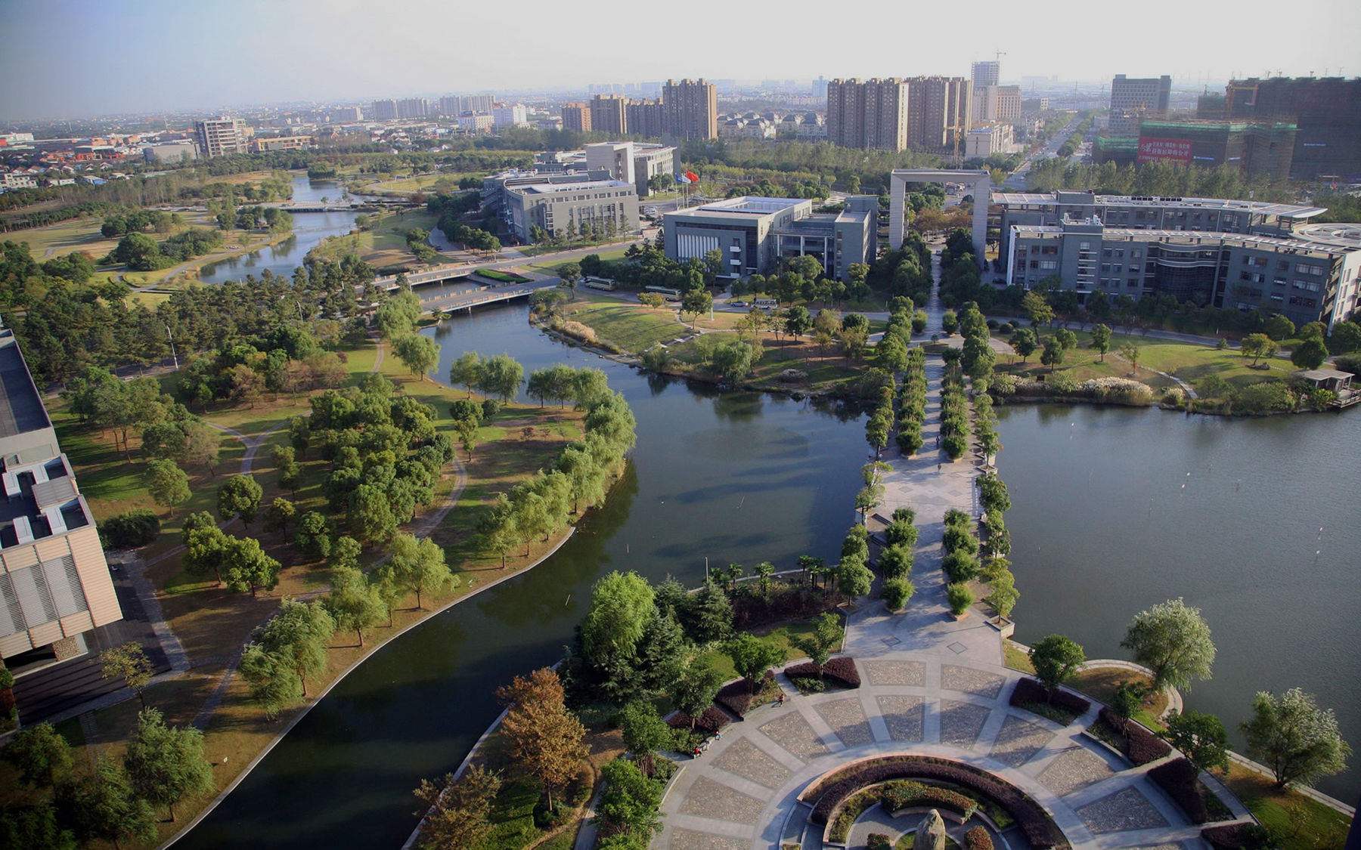
Visual Tracking with Correlation Filters and Siamese Networks
Bachelor’s Thesis
June 2020
Student: Weijiang Xiong
Supervisor: Prof. Changhong Fu
School of Mechanical Engineering
Notes:
I want to talk about visual object tracking
and I’ll briefly introduce two kinds of methods, which are named correlation filters and Siamese networks.

Slide 36
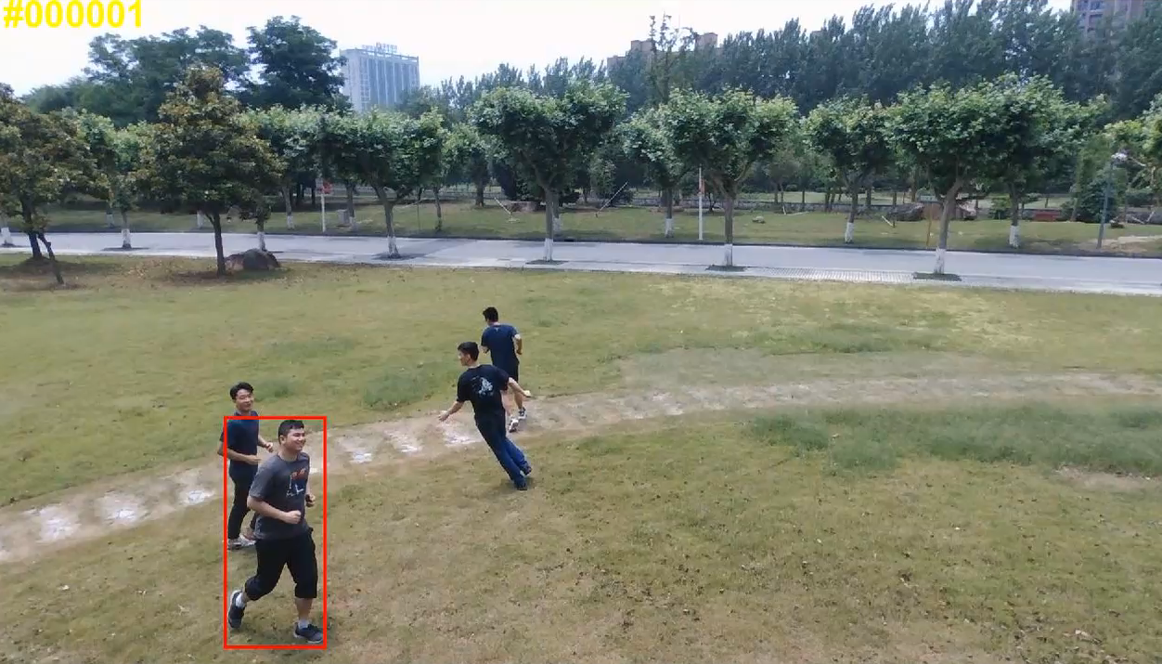
Visual Object Tracking
Correlation Filter Siamese Network
Notes:
(start video) now I’m sure you can easily see some guys here, and you know precisely where they are and how they moves.
Such a task is visual object tracking, it’s easy for us, because we humans have excellent vision systems.
If we can make a computer do this, it would be artificial intelligence!
Can we? Yes! Actually, in this video, the green box is created by an algorithm with correlation filter, and the red one comes from a Siamese network.

Slide 37
Contents
Overview and Basic Workflow
Visual Tracking with Correlation Filters
Siamese Networks for Visual Tracking
Discussion and Summary
Notes:
About visual tracking, we’ll first define what it is and how it works.
Then, we will go through the two kinds of methods, and finally a brief summary

Slide 38
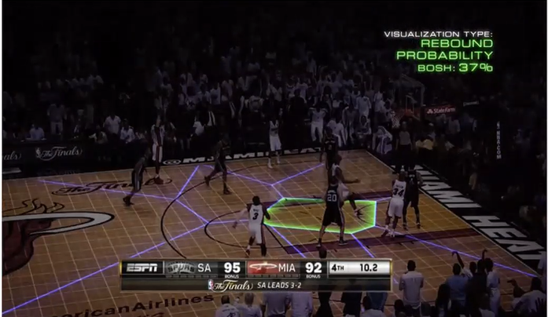
Definition and Scope
Visual Object Tracking Problem
Continuously estimate the motion of an object in a video, given its initial location and scale
Where it is at first => How it moves later on
Research (mainly)
Active topic in robotics and artificial intelligence
Evolve together with other computer vision tasks
Application
Sport video analysis, in FIFA and NBA
Visual surveillance for security (with object detection)
Notes:
Formally, the visual tracking problem means to (read the slide)
that is, we know where it is at first, and we want to know how it moves later on.
Visual tracking is an active research topic in robotics and AI
For applications, it could be used in sport video analysis, or visual surveillance.
In this example, if we know the motion of this player in the game, we can place a marker on him, and then the audience could better see where he is.
As for the people who make strategies for the team, they would be happy to have the motion data of all players, so they can analyze the the behavior of their opponents.

Slide 39
Basic Workflow
Algorithm Diagram
Image
Sequence
Data Preparation
Feature Extraction
Existing Model
Prediction
Object
Motion
Initial
Location
Frame by Frame
Skip in first frame
Model Update
Machine Learning
New Location
Essential Steps
  Feature Extraction: summarize the information in an image
  Machine Learning: fit the extracted information with a model
  Prediction: use the model to match newly extracted features
Notes:
In general, a visual tracking algorithm takes an image sequence, or a video, and initial object location
then it predicts the motion of the object frame by frame, with a five stage strategy.
In such an algorithm, feature extraction and machine learning are most essential
Each loop we make prediction for one single frame, data preparation means preprocessing, feature extraction will (read the slide)
at the beginning, we know where the object is, so we can skip the prediction and go to machine learning, where we (read the slide)
After model update, we are ready for a new frame.
The only thing different is, we use the existing model to predict the object location, and refresh the machine learning model with the new location.

Slide 40
Contents
Overview and Basic Workflow
Visual Tracking with Correlation Filters
Siamese Networks for Visual Tracking
Discussion and Summary
Notes:
Then we take a look at correlation filters, which is the traditional part of visual tracking.

Slide 41
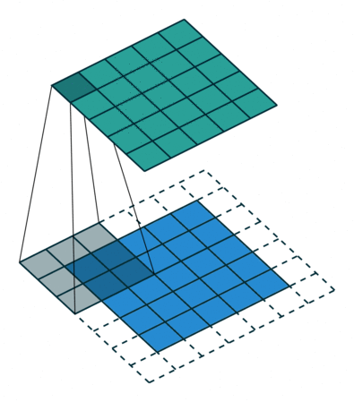
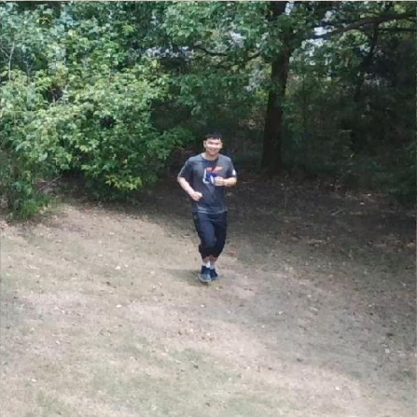
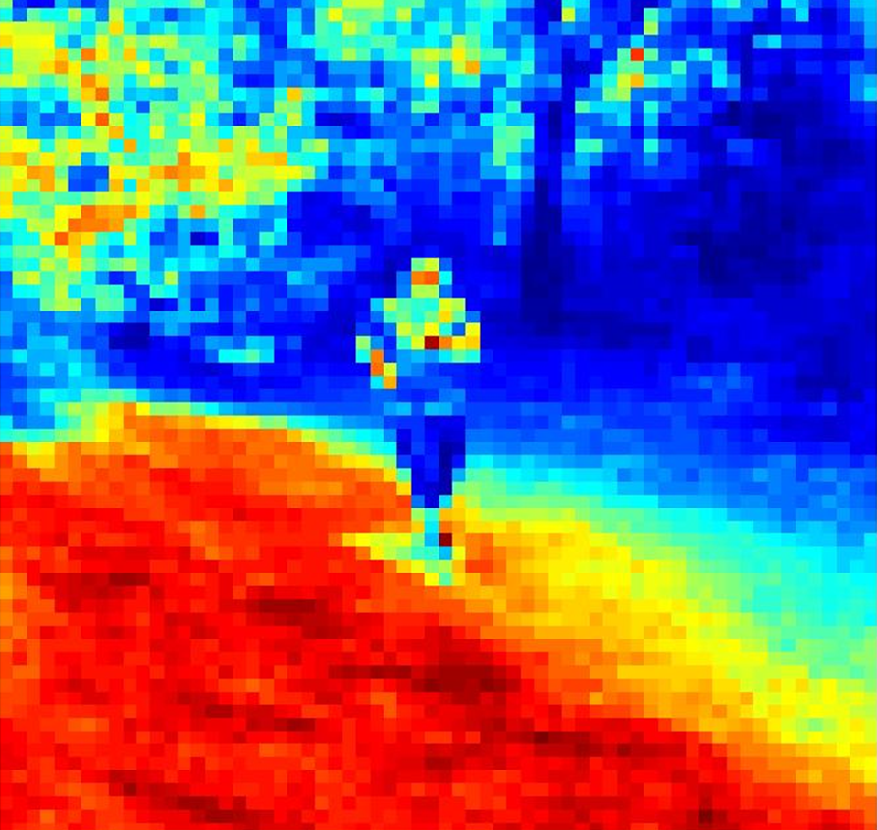
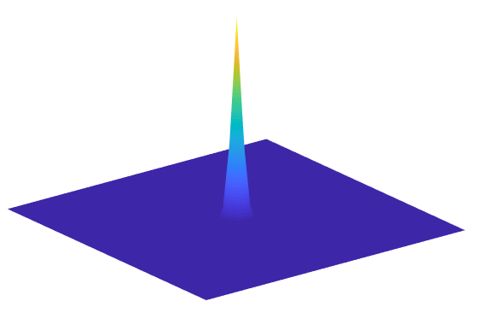
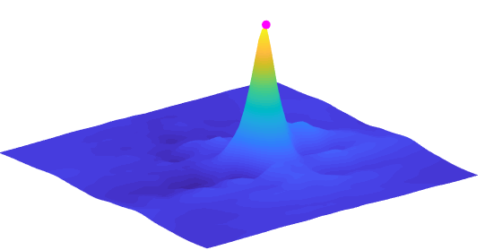

Correlation Filters (CF, traditional)
Learning as Optimization
Correlation
Basic Formula
$$\underset{f{ }}{\arg{min}}ℒ\left(f\right)={\left\|x⋆f−y\right\|}^{2}+λ{\left\|f\right\|}^{2}$$
$x⋆f$, $x$ and $f$
Object location
Feature Extraction
(statistical properties)
Correlation
Image
$$x$$
Similar
Digital Filter $f$
Small Value
$$x⋆f$$
Prediction
$$y$$
label
Matrix
Loss Function $ℒ$
Small Norm $λ{\left\|f\right\|}^{2}$
Small Difference ${\left\|x⋆f−y\right\|}^{2}$
Henriques, João F., et al. "High-speed tracking with kernelized correlation filters." IEEE TPAMI 37.3 (2014): 583-596.
Notes:
By traditional, we mean NOT deep learning, because the learning part is described as an optimization problem
There’s going to be some math, but don’t be afraid, we can understand it intuitively
this formula means to find a digital filter f, that makes this function as small as possible, solve the formula we have an f, and let’s see how to use the filter
Given an image with the object at the center, we first summarizes its statistical properties
for example, this feature indicates the brightness of the image, the things under the sun are marked in red, and those in shadows are marked in blue.
Then we want to have a filter, which we can use to find the object with a correlation
and a correlation means, scan f over x, multiply the overlapped cells and add them up.
If the filter is good, we will have a good result, a sharp shape, and we can simply choose the peak
But a good f doesn’t come naturally, we have to do something. and what we need to do is to make the correlation result to look like this label function.
Since we have placed the object at the center and this label function has a high value at the cente,
so the label function will have a high value on the object
If the correlation result looks like the label, it will also have a high value on the object
To make them similar, we need a small difference term in the loss function
to further prevent overfitting, we don’t want large values in the filter matrix
In short, we want to find a filter, whose correlation result with feature will tell us where the object is.
to get such a filter, we need to solve this formula

Slide 42
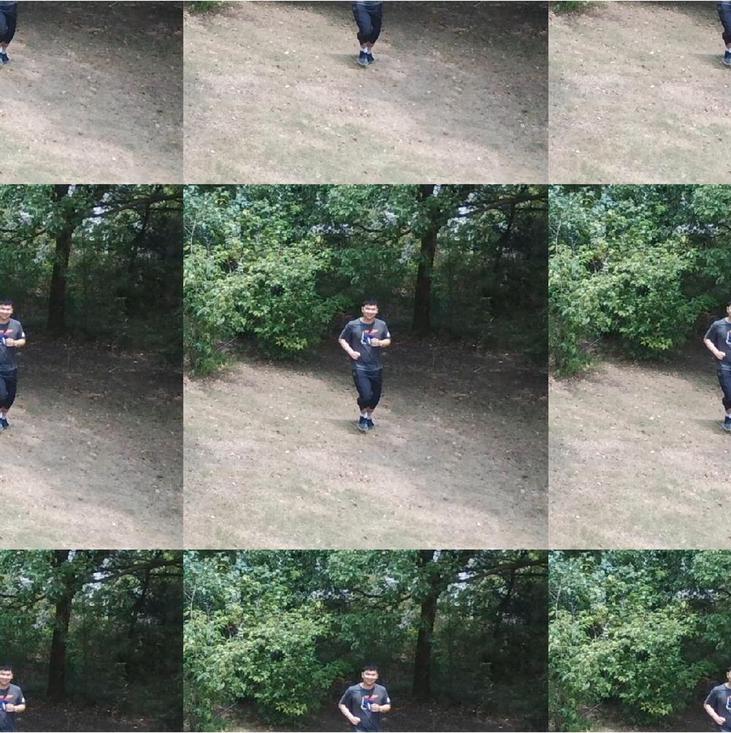
















Speeding Up in Frequency Domain
Original Object function, with a Circulant Correlation
$$\underset{f{ }}{\arg{min}}ℒ\left(f\right)={\left\|x⋆f−y\right\|}^{2}+λ{\left\|f\right\|}^{2}$$
Circulant Correlation is equivalent to multiplication with a Circulant matrix $C(x)$
$$x⋆f=C(x)f$$
$$[\begin{matrix}a & b & c & d & e\end{matrix}]$$
Filter $f$
Feature $x$
$$\begin{matrix}⋯ \\ ⋯ \\ ⋯ \\ ⋯ \\ ⋯ \end{matrix}$$
$$\begin{matrix}⋯ \\ ⋯ \\ ⋯ \\ ⋯ \\ ⋯ \end{matrix}$$
$$y_{1}$$
$$y_{2}$$
$$≈$$
$$y_{3}$$
$$y_{4}$$
$$y_{5}$$
$C(x)$ $f$
$$≈$$
$$y$$
Henriques, João F., et al. "High-speed tracking with kernelized correlation filters." IEEE TPAMI 37.3 (2014): 583-596.
Notes:
this basic method had a strong impact, because this speeding up technique

Slide 43



Speeding Up in Frequency Domain
Original Object function, with a Circulant Correlation
$$\underset{f{ }}{\arg{min}}ℒ\left(f\right)={\left\|x⋆f−y\right\|}^{2}+λ{\left\|f\right\|}^{2}$$
Circulant Correlation is equivalent to multiplication with a Circulant matrix $C(x)$
$$x⋆f=C(x)f$$
Circulant Matrix can be diagonalized by the discrete Fourier matrix $F$
$$C(x)=Fdiag(\hat{x})F^{H}$$
Learn filter in frequency domain
$$\hat{f}=\frac{\hat{x}⋅\hat{y}}{{\hat{x}}^{∗}⋅\hat{x}+λ}$$
Back to space domain
$$max\left(x⋆f\right)=max(ifft\left({\hat{x}}^{∗}⋅\hat{f}\right))$$
Henriques, João F., et al. "High-speed tracking with kernelized correlation filters." IEEE TPAMI 37.3 (2014): 583-596.

Slide 44





Improvements in CF ($x⋆f$)
Training Better Filter $f$
$$\underset{f{ }}{\arg{min}}ℒ\left(f\right)=\frac{1}{2}\sum_{j=1}^{n}{{\left\|f⋅P⋅(x∆[τ_{j}])−y_{j}\right\|}^{2}}+{\left\|f\right\|}^{2}$$
BACF
Background
$$\underset{f{ }}{\arg{min}}ℒ\left(f\right)=\frac{1}{2}{\left\|x⋆f−y\right\|}^{2}+{\left\|w⋅f\right\|}^{2}$$
SRDCF
Assign Weights
Using Better Features $x$
Features from Convolutional Neural Network
(CNN, stronger feature extraction tool)
Semantic features:
high value on objects (two guys)
low value on backgrounds
Higher accuracy, lower speed
Image
Features
BACF: Kiani Galoogahi, Hamed, Ashton Fagg, and Simon Lucey. "Learning background-aware correlation filters for visual tracking ICCV. 2017.
SRDCF: Danelljan, Martin, et al. "Learning spatially regularized correlation filters for visual tracking." ICCV. 2015.
Notes:
In fact, the basic filter can be improved
Since a correlation only requires two things, feature x and filter f, so to improve the correlation, we can improve either x or f or both of them
Abetter filter usually means a more complicated loss function, but that’s more math and more headache
better features comes from CNN, you can think of it as a stronger feature extraction tool
those features are called semantic features, because they already have high value on objects and low value on backgrounds
for example, the first feature has high values only on the two guys, while the rest of it is marked in blue

Slide 45




Learning Better Filters
Impose Intuition by Regularization
$$\underset{f{ }}{\arg{min}}ℒ\left(f\right)=\frac{1}{2}\sum_{j=1}^{n}{{\left\|f⋅P⋅(x∆[τ_{j}])−y_{j}\right\|}^{2}}+{\left\|f\right\|}^{2}$$
BACF
Remove
Background
$$P$$
Focus on the object
(element-wise multiplication)
SRDCF
$$\underset{f{ }}{\arg{min}}ℒ\left(f\right)=\frac{1}{2}{\left\|x⋆f−y\right\|}^{2}+{\left\|w⋅f\right\|}^{2}$$
$$z$$
$w$ Spatial Regularizer
Assign
Weights
Do not pay attention to borders
(element-wise multiplication)
$$y$$
$$0$$
$$x$$
BACF: Kiani Galoogahi, Hamed, Ashton Fagg, and Simon Lucey. Learning background-aware correlation filters for visual tracking ICCV. 2017.
SRDCF: Danelljan, Martin, et al. Learning spatially regularized correlation filters for visual tracking. ICCV. 2015.
Notes:
more specifically
The BACF algorithm proposes a cropping operation P, which removes some background part make the filter focus on the object
The intuition here is the object is more important
Similarly, the SRDCF imposes different weights W. The spatial regularizer here means it has different values at different places, and W tells the filter not to pay attention to border part.

Slide 46
Contents
Overview and Basic Workflow
Visual Tracking with Correlation Filters
Siamese Networks for Visual Tracking
Discussion and Summary
Notes:
people are using deep learning in many tasks
and for visual tracking, the most representative method is Siamese network

Slide 47

Siamese Networks (Similarity by Deep Learning)
Basic Structure (SiamFC)
Find something most similar to the template
Template
Correlation
127x127x3
Same
Network
6x6x128
17x17
Search
(larger)
Score Map
(pick highest)
22x22x128
Lots of information
255x255x3
Features
Feature Extraction
Similarity Metric
Bertinetto, Luca, et al. Fully-convolutional siamese networks for object tracking. ECCV 2016.
Notes:
This is a kind of method, that tells us the similarity of two images.
Generally, a Siamese network consists of a feature extractor and a similarity metric.
At first, we know where the object is, so we keep it as a template, and all the subsequent work are meant to find the object that is most similar to this template.
To do this, we first specify a larger search window, that is where the object is likely to be.
we feed the template and search window through the same network. and that is where the name Siamese comes from.
Imagine, if we have two duplicate images, put them into the same network, the resulting features would be exactly the same.
But here we have incorporated something else in the searching image, so only part of the features will be the same, but which part, and how can we find it?
We can scan one over anther, and see if the overlapped features are the same, and that’s a correlation.
A bad news is, probably we won’t find something exactly the same, but something similar instead, and we pick the most similar one.
A problem here is, we have thousands of features here, and they must contain a lot of information
but the result is just 17 x 17, can we do something better?

Slide 48



Improve tracking with Segmentation
SiamMask
Accurate description
Template
$$h_{φ}$$
$$f_{θ}$$
Segmentation
Feature
*
$$b_{σ}$$
Localization (RPN, bbox)
Searching
Same
Network
Correlation Result
25×25×256
$$f_{θ}$$
$$s_{φ}$$
Classification
(score map, still pick max here)
Feature
Feature Extraction
Similarity Metric
Wang, Qiang, et al. Fast online object tracking and segmentation: A unifying approach. CVPR 2019.
Notes:
And yes!
In this improved network SiamMask, the feature extraction part is the same as the basic one,
the difference is, in addition to the location branch, SiamMask has two more sub structures that exploit the information in the correlation result, and provides accurate description of the object
one is for object scale and the other for detailed shape. And this shape is called a mask, that is why this network is named SiamMask

Slide 49









Discussions
Problems in Correlation Filters and Deep Neural Networks
Shifted Image x[i] in circulant correlation
Corresponding label y[i]
Shifted Image x[i] $×$filter f = label value y[i]
Similar features for similar objects
Boundary Effect: Correlation contains a weighted sum of false data (except the middle one)
(no need to consider different instances in image classification task)
Focus on the central part: BACF, SRDCF
Use low-level features (with more texture)
Notes:
But problems arises if we observe more in detail.
correlation filters compute a correlation between features and the filter, but in fact they implicitly generates a bunch of shifted images.
As you can see, some them are not so real, especially the left most and right most ones.
This problem is known as boundary effect, and BACF and SRDCF are meant to solve it.
Siamese networks extract features with CNN, and similar objects tend to have similar features.
In this picture, you can see some of the feature maps have high value at the location of the two persons.
This problem arises because the CNNs are usually trained to do image classification, these two guys are the same when we talk about classification, because they are both human,
but in the sense of tracking, they are different, because they are different persons
This contradiction makes it difficult to tell them apart, and to make up for it, we can use low-level features.

Slide 50

Combine the score maps
Different methods, but similar workflow
Extract features, compute a correlation, get a score map, pick the max value
Fusion method (named DAFT)
Step1: Linear Combination of $log⁡(CF_score_map +1)$(rescale to 0~1) and a Cosine window
Step2: Linear Combination of the result in step 1 and the score map from a Siamese network
Used SiamMask and ECO-HC in thesis, but combination method is general
SiamMask: Wang, Qiang, et al. Fast online object tracking and segmentation: A unifying approach. CVPR 2019.
ECO-HC: Danelljan, Martin, et al. "Eco: Efficient convolution operators for tracking." CVPR. 2017.

Slide 51
Quantitative Results
Performance on UAV123
Precision: The percentage of frames, where the center of the predicted bbox is no further than CLE Threshold from the true center (difficulty decreases from left to right, number from 20px)
Success Rate: The percentage of frames, where the IOU between the predicted and true bbox are larger than threshold (difficulty increases from left to right, number from AUC)
Precision
Success Rate
CLE Threshold
IOU Threshold
Mueller, Matthias, Neil Smith, and Bernard Ghanem. "A benchmark and simulator for uav tracking." European conference on computer vision. Springer, Cham, 2016.
Notes:
Generally in visual tracking, the most important steps are feature extraction and machine learning.
For algorithms with correlation filters, the core problem is filter optimization
A Siamese network consists of feature extraction and a similarity metric
Finally, when designing a tracking algorithm, we always need trade off among explainability, accuracy, speed and computation load
That is because we want to do tracking in realtime, such as video streaming for the application in NBA.

Slide 52
Summary
Key Takeaways
Feature extraction and machine learning are most important
The core problem on correlation filter side is filter optimization
Siamese network = feature extraction + similarity metric
Fusion method works well
Notes:
Generally in visual tracking, the most important steps are feature extraction and machine learning.
For algorithms with correlation filters, the core problem is filter optimization
A Siamese network consists of feature extraction and a similarity metric
Finally, when designing a tracking algorithm, we always need trade off among explainability, accuracy, speed and computation load
That is because we want to do tracking in realtime, such as video streaming for the application in NBA.

